Slide 1
STUDYING IN THE NETHERLANDS
ITC I FACULTY OF GEO-INFORMATION SCIENCE AND EARTH OBSERVATION

Slide 2
IN THIS PRESENTATION
01.
02.
03.
04.
05.
06.
Studying in the Netherlands
The University of Twente
The Faculty ITC
Master Programmes
Alumni
Stay in Contact

Slide 3
STUDYING IN THE NETHERLANDS

Slide 4
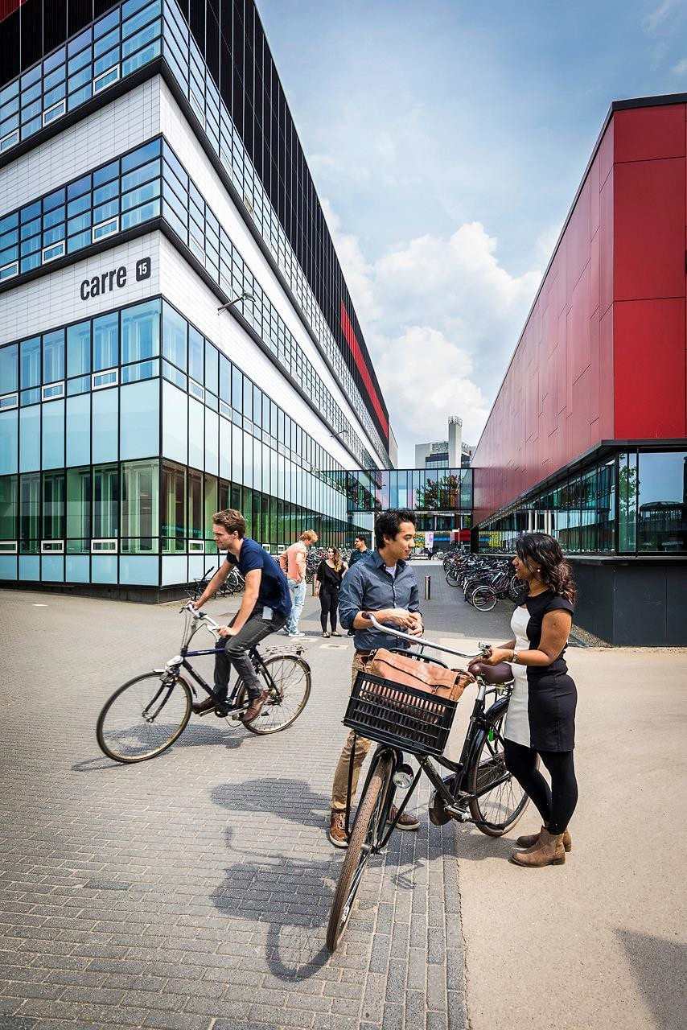
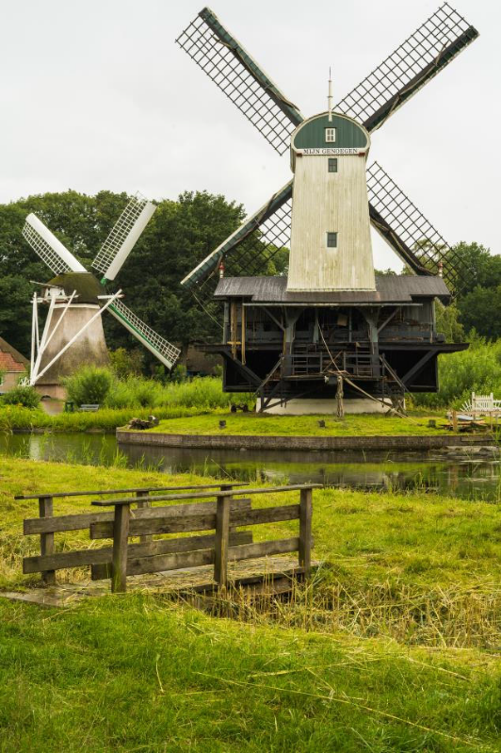
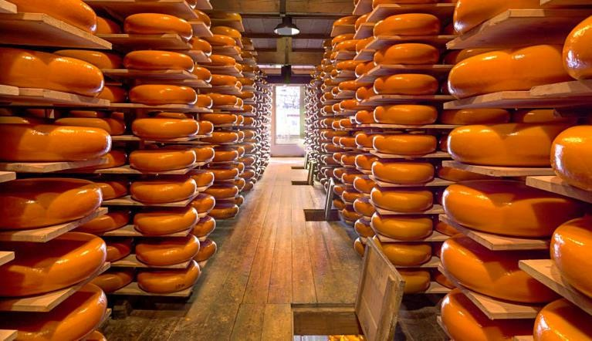
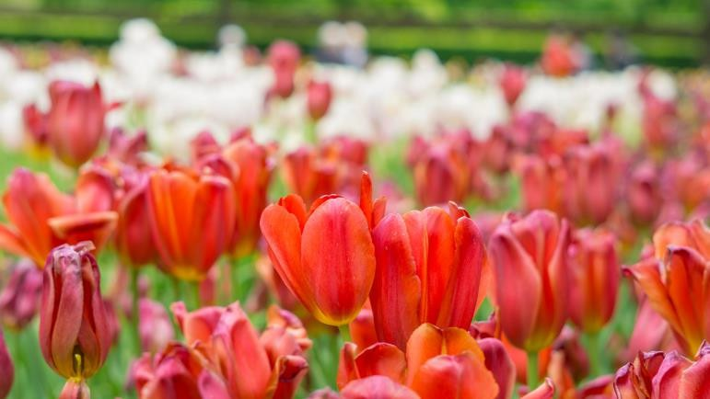
WHAT COMES TO YOUR MIND WHEN YOU HEAR THE NETHERLANDS?
Notes:
This slide is just to break the ice (optional)

Slide 5
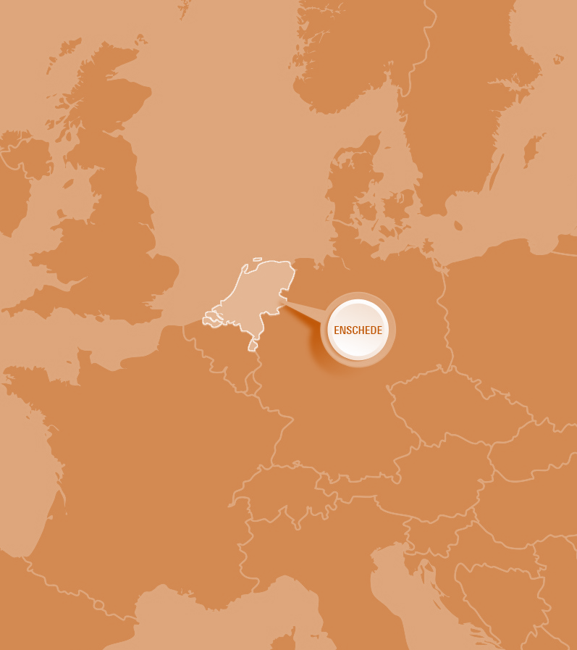
BEAUTIFULLY LOCATED IN THE NETHERLANDS,
GATEWAY TO EUROPE
A distinctive modern and lively university town
At the Eastern border of the Netherlands
Surrounded by remarkable spots of natural beauty and tranquility
Excellent connections to Amsterdam, Brussels, Paris, London, Zurich and Berlin
Notes:
From the other slide I would transition to: “Yes the NL is the land of windmills and tulips, but it is also an international country, due to its trading nature… “
• Dutch people, traders from origin, which makes the
country very international
• #1 in English Proficiency Index (C1)
• Quality of education
• High living standards: Excellent infrastructure and safety
network

Slide 6
WHY STUDY IN THE NETHERLANDS?
Good educational facilities
A lot cheaper than the USA, UK, Australia
Clean air
You don’t have to be great before you start!

Slide 7
DUTCH FACTS
WHAT MAKES THE NETHERALNDS A CONFORTABLE COUNTRY TO LIVE AND STUDY
They are independent and rank high in gender equality
They respect privacy and are very punctual
They are straight-forward and love their coffee
Rank high in health and quality of life, and cycling is safe in the Netherlands
Fun Fact: The Dutch are some of the tallest in the world

Slide 8
THE UNIVERSITY OF TWENTE
01.
AN INTRODUCTION

Slide 9
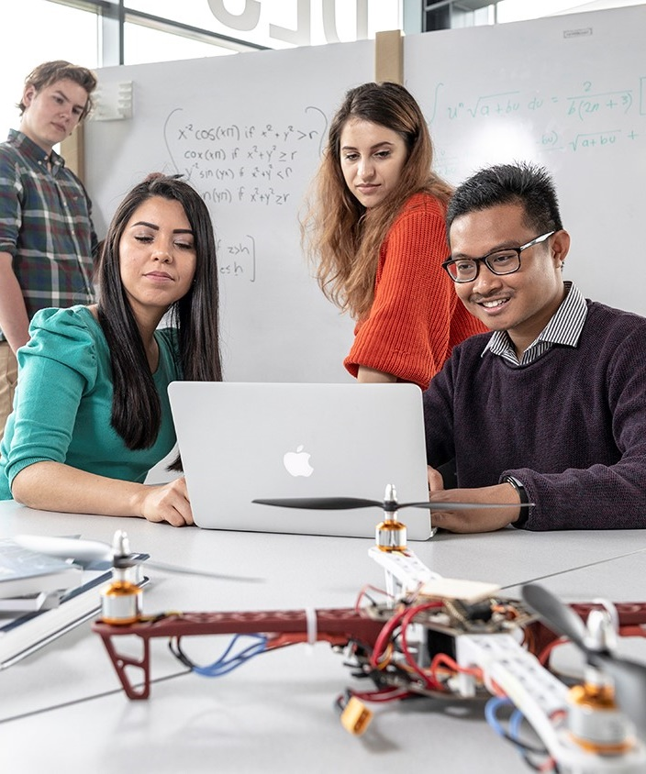
HIGH TECH HUMAN TOUCH
Combining technical and social sciences to make a difference in society
Cross-disciplinary way of working
Internationally oriented and highly personal education
Entrepreneurial: courage over comfort
Inclusive: student over system
Open: community over campus

Slide 10
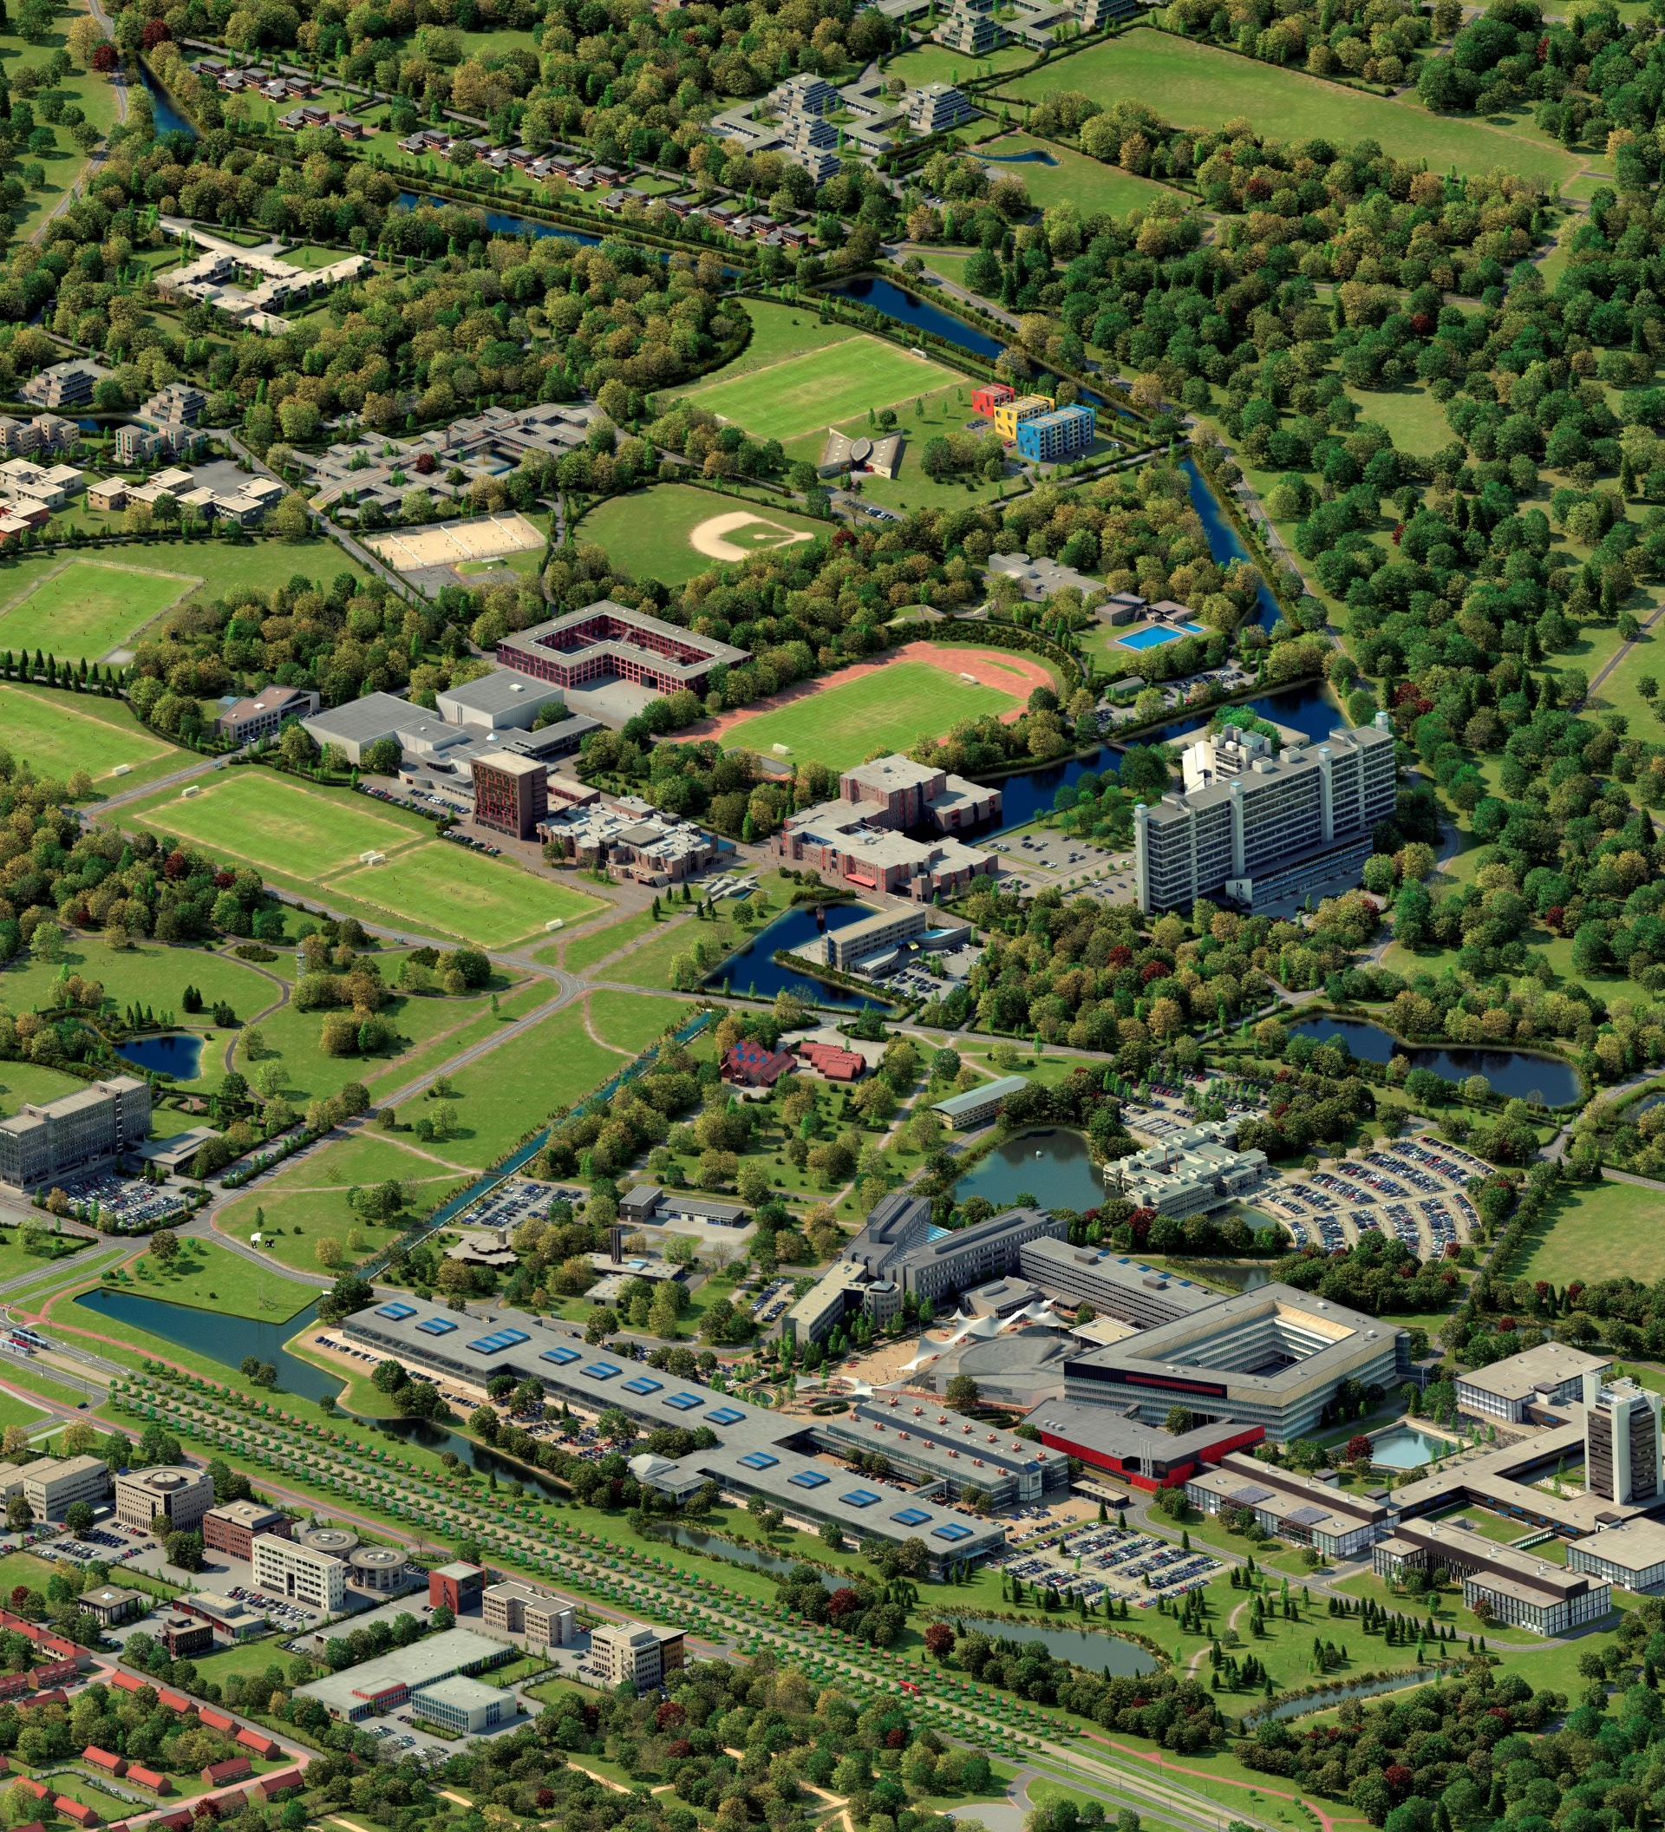
LIVING SMART CAMPUS
Innovative and vibrant campus
Modern sports facilities
Wide range of arts and culture on campus
Shops, healthcare, housing and catering: all on campus

Slide 11
STUDENT LIFE
33% international students, 114 nationalities
More than 60 sports associations ranging from Archery to Yoga
More than 100 student and study associations
Multidisciplinary student teams such as Drone Team Twente, Esports Team Twente and Solar Team Twente
Well known on-campus events include the Kick-In, Batavierenrace, and Create Tomorrow

Slide 12
FACTS AND FIGURES
12,903
TOTAL NUMBER OF STUDENTS ENROLLED
2020: 12,544
NUMBER OF FIRST-YEAR STUDENTS (BSC + MSC)
2020: 4,465
PERCENTAGE OF INTERNATIONAL STUDENTS
2020: 32
NUMBER OF DIPLOMAS ISSUED
BACHELOR: 1,532 - MASTER: 1,738
4,676
33
3,270

Slide 13
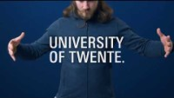

Slide 14
FACULTIES
SCIENCE AND TECHNOLOGY (TNW)
ELECTRICAL ENGINEERING, MATHEMATICS AND COMPUTER SCIENCE (EEMCS)
ENGINEERING TECHNOLOGY (ET)
BEHAVIOURAL, MANAGEMENT AND SOCIAL SCIENCES (BMS)
GEO- INFORMATION SCIENCE AND EARTH OBSERVATION (ITC)

Slide 15
ITC FACULTY
02.
GEO-INFORMATION SCIENCE
AND EARTH OBSERVATION

Slide 16
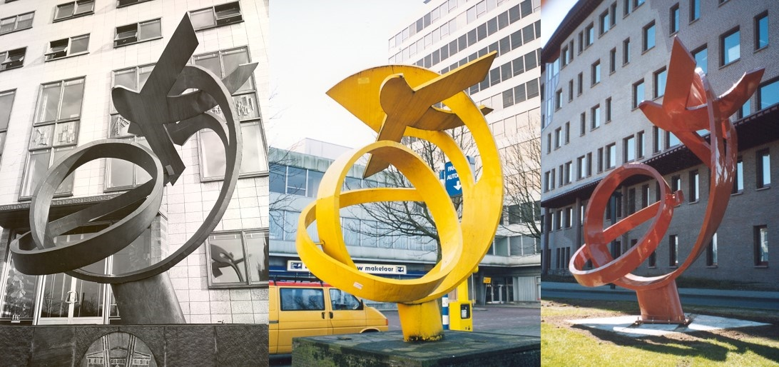
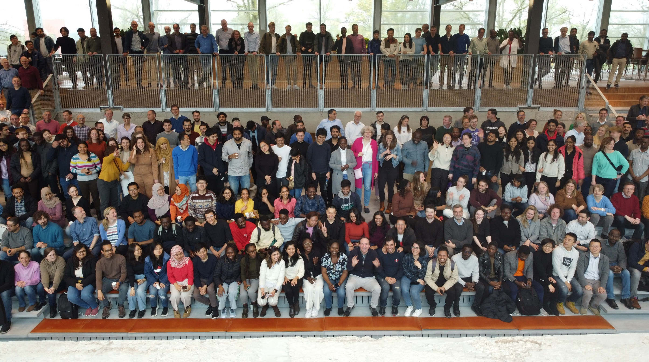
ITC FACULTY OF GEO-INFORMATION SCIENCE AND EARTH OBSERVATION
ITC is recognized worldwide for achievements in capacity development in the field of geo-information science and earth observation. We do this by education, research and institutional strengthening.

Slide 17
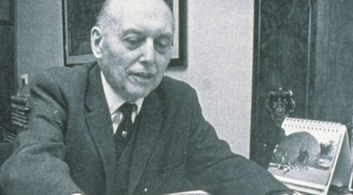
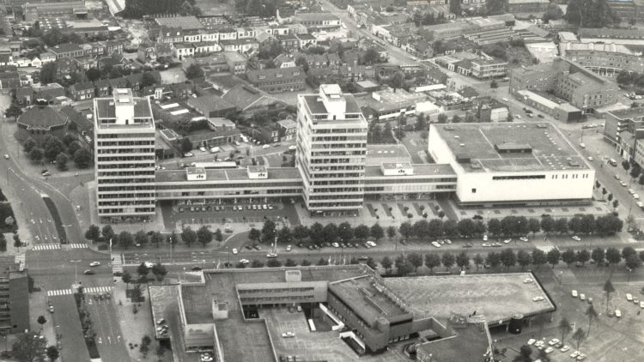
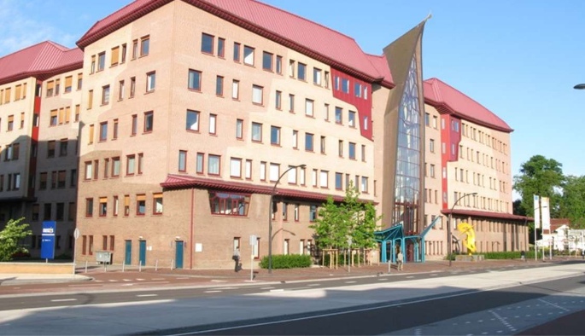
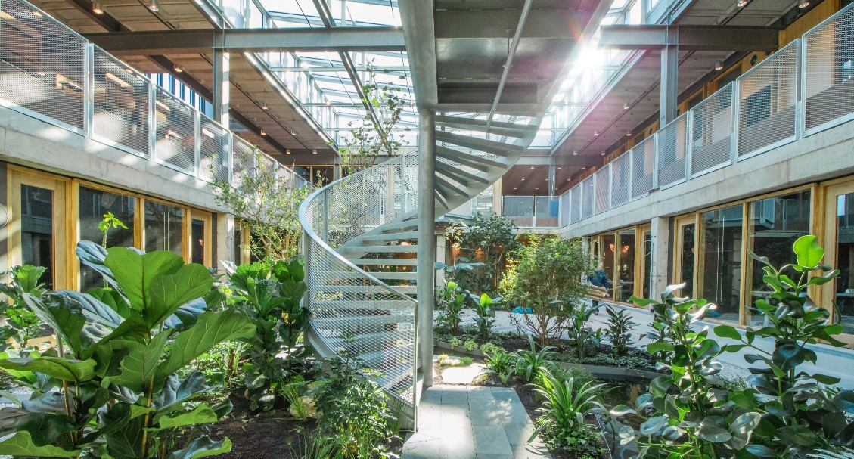
ACTIVE FOR MORE THAN 70 YEARS
1950
ITC came into existence (International Training
Centre for Aerial Survey)
1971
ITC moves from
Delft to Enschede
1996
ITC moves to Hengelosestraat in Enschede
2010
ITC becomes a Faculty of the University of Twente
2023
ITC moves to University of Twente’s
campus

Slide 18
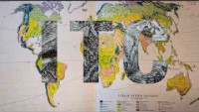

Slide 19
OUR MISSION
Capacity development is our mission, where we apply share and facilitate the effective use of knowledge and tools for tackling global wicked problems.
OUR VISION
Our vision is of a world in which researchers, educators and students collaborate across disciplinary and geographic divides with governmental and non-governmental organisations, institutes, businesses and local populations to surmount today’s complex global challenges and to contribute to sustainable, fair, digital societies.

Slide 20
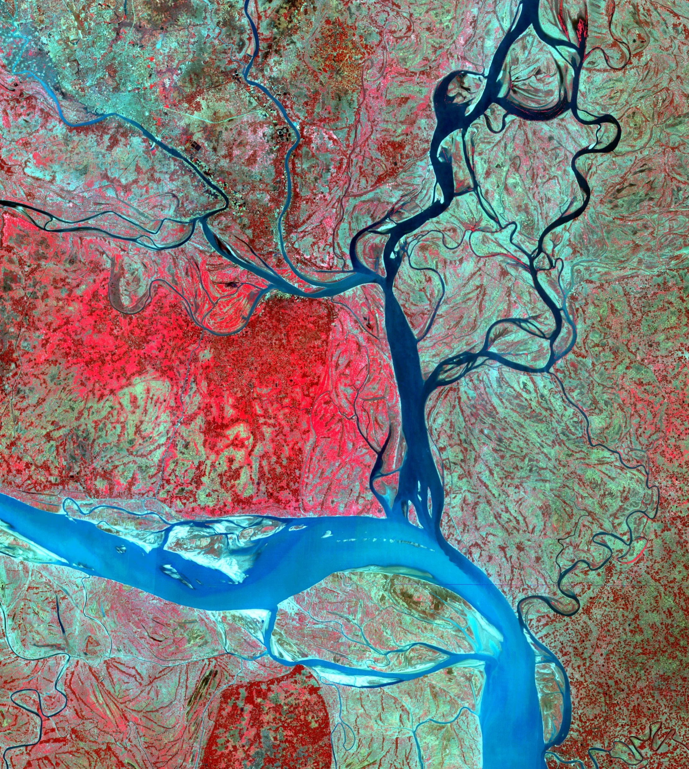
OUR PURPOSE
Our purpose is to enable our many partners around the world to track and trace the impact of today’s global challenges. We are here to identify and understand vulnerability and use geospatial solutions to convert it into resilience.

Slide 21
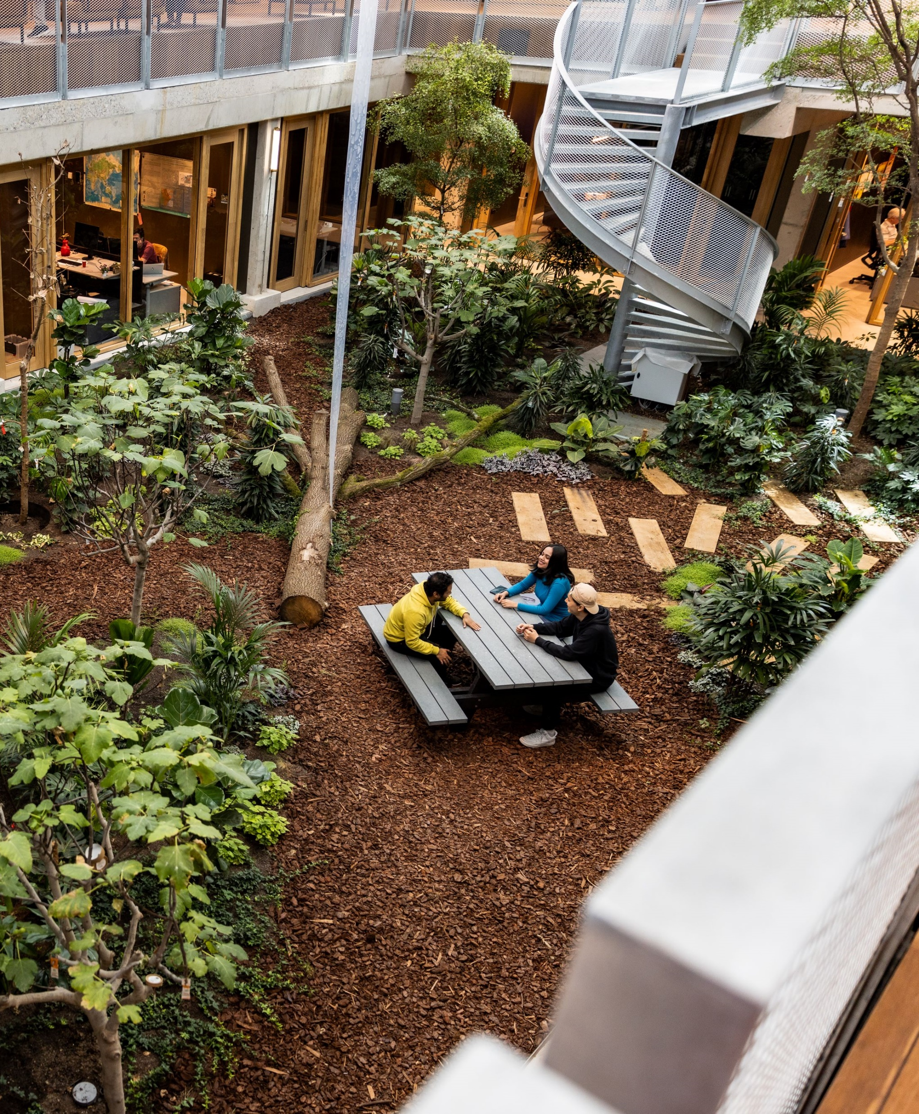
ITC’S SIX SCIENTIFIC DEPARTMENTS
Earth Observation Science (EOS)
Applied Earth Sciences (AES)
Geo-information Processing (GIP)
Natural Resources (NRS)
Urban and Regional Planning and Geo-information Management (PGM)
Water Resources (WRS)

Slide 22
FACTS AND FIGURES
92
SUPPORTING STAFF
SCIENTIFIC STAFF
190
SUPPORTING STAFF
SCIENTIFIC STAFF
77%
10%
13%
22%
34%
44%
DUTCH
EU
NON-EU
EU
DUTCH
NON-EU
Notes:
* Per May 2023

Slide 23
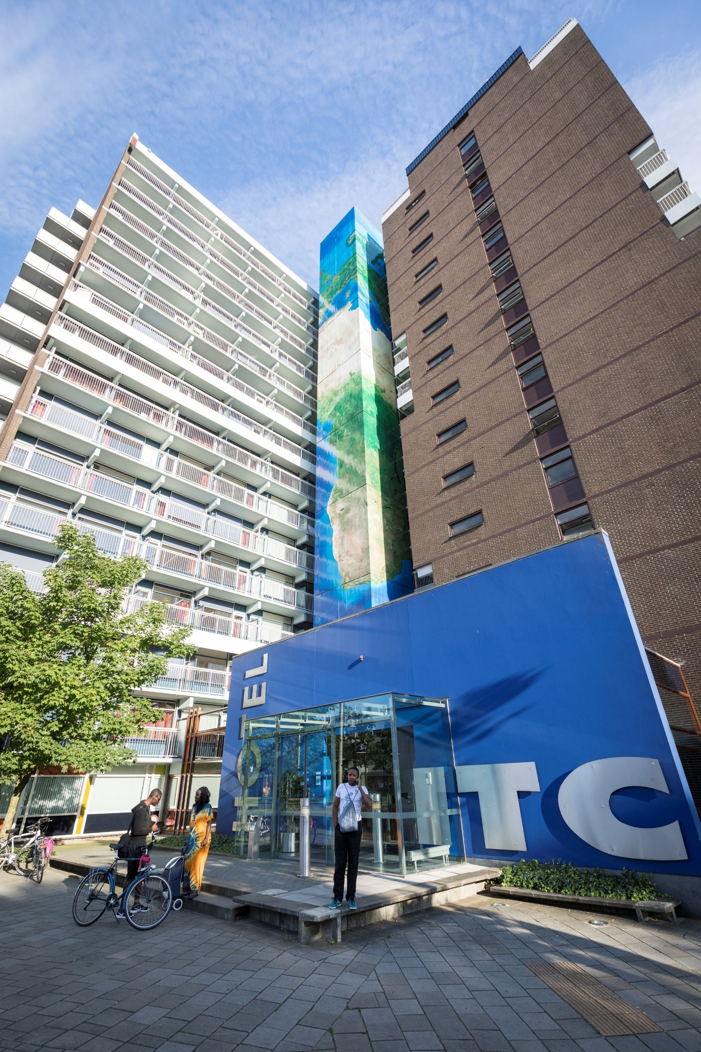
FACILITIES FOR OUR STUDENTS
Well furnished rooms and apartments in the ITC International Hotel
The hotel includes 24-hour reception, self-service laundry and a free of charge internet connection
Laboratory facilities at ITC’s Langezijds building
A study and learning centre
Access to all the sports, arts and culture offerings on UT’s campus

Slide 24
EDUCATION
GETTING EQUIPPED TO CHANGE THE WORLD

Slide 25
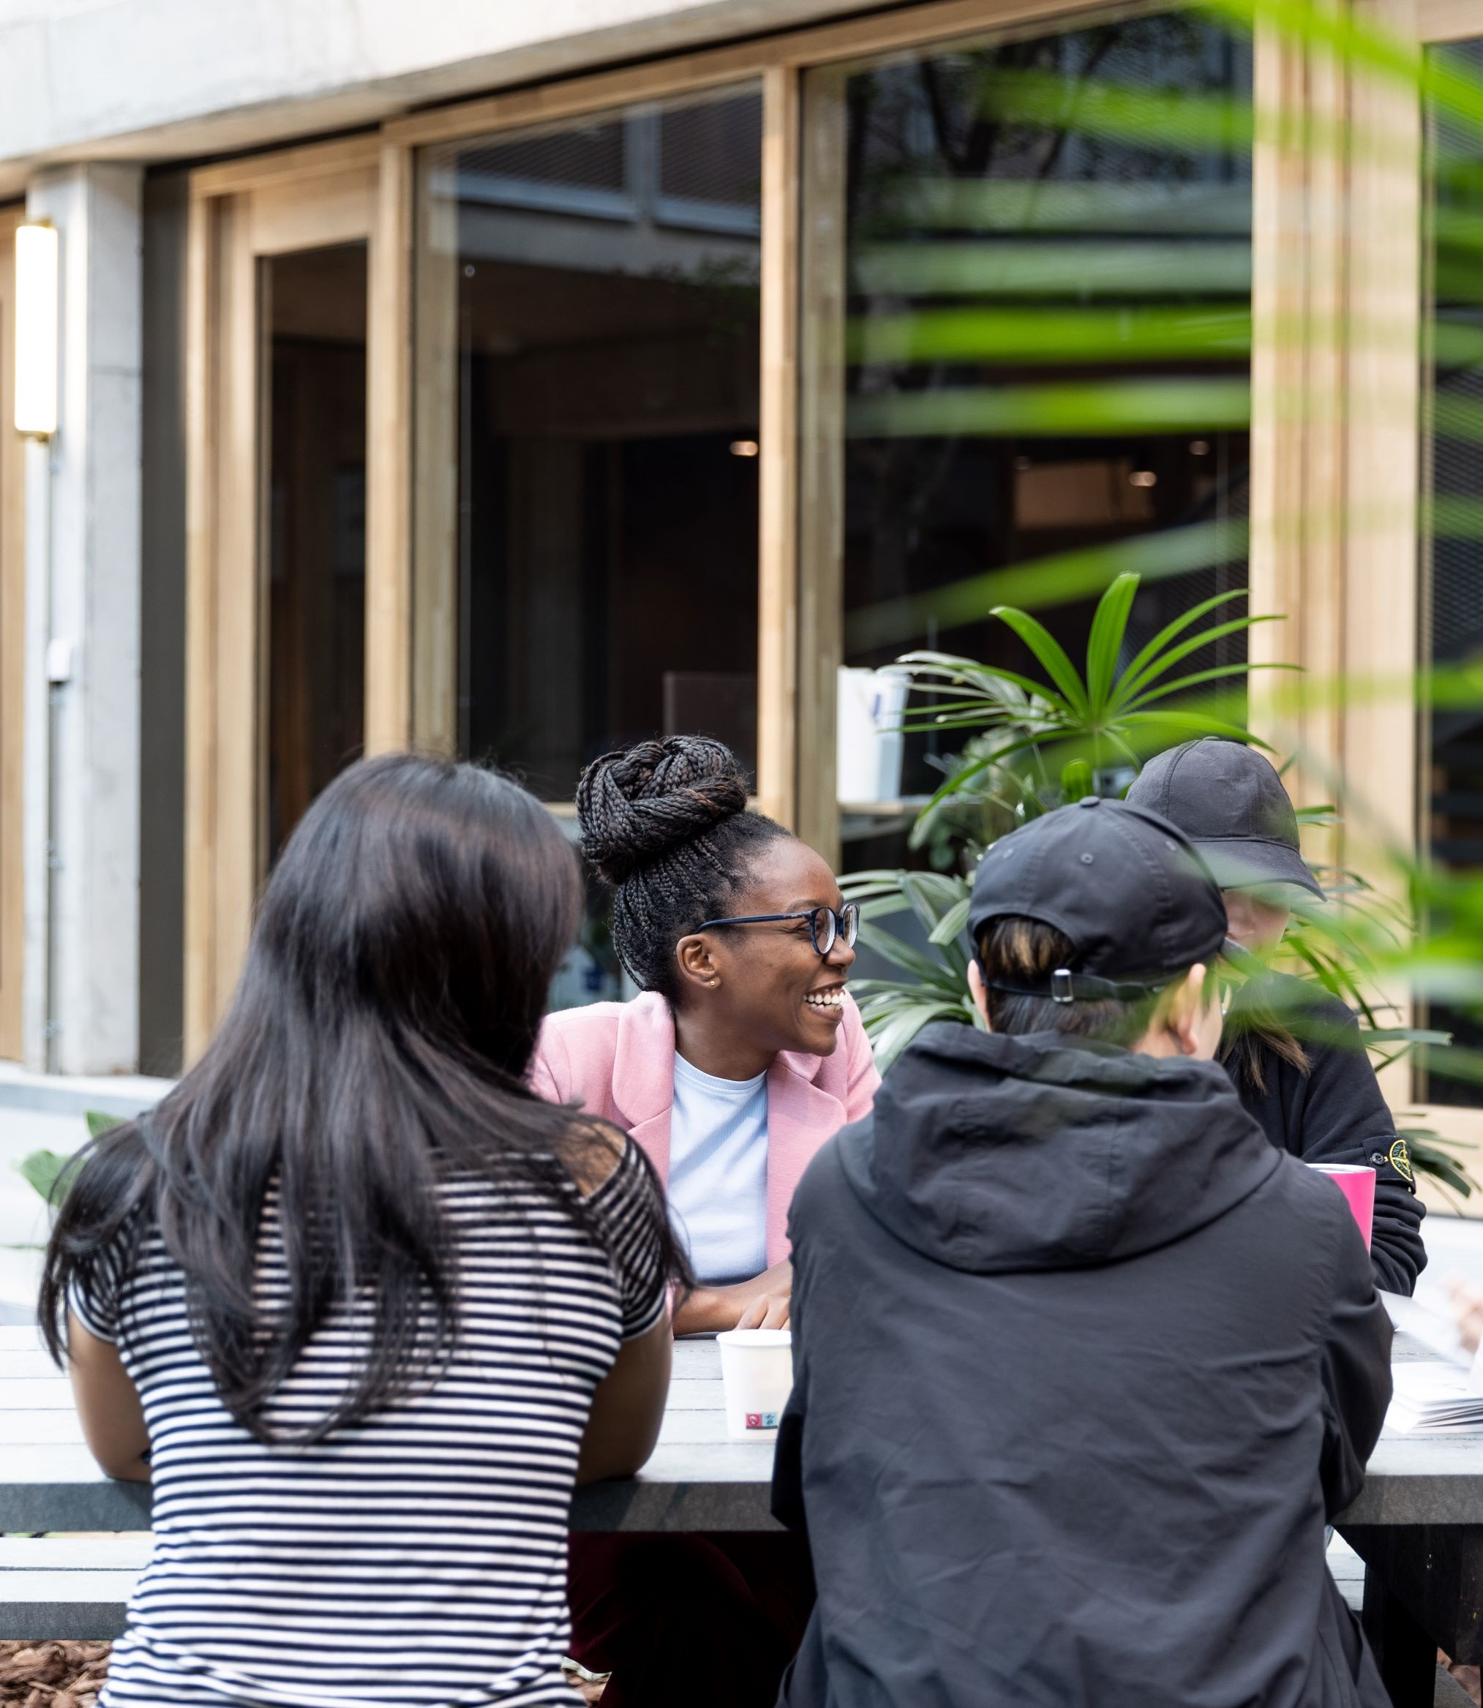
OUR EDUCATION
The overarching goal of our education is clear: to equip our students with state-of-the-art knowledge on geo-information science and earth observation, and with the skills and competencies they will need to be change leaders in a changing society – including innovative, inspiring and self-critical leadership.

Slide 26
EDUCATIONAL OFFER AT ITC INCLUDES:
Master Spatial Engineering (M-SE)
Master Geo-Information Science and Earth Observation (M-GEO)
PhD programme
Three joint Master’s (GIMA, Cartography and GEM)
Postgraduate diploma programme, certificate courses and individual modules, distance education courses and tailor-made courses
Also:

Slide 27
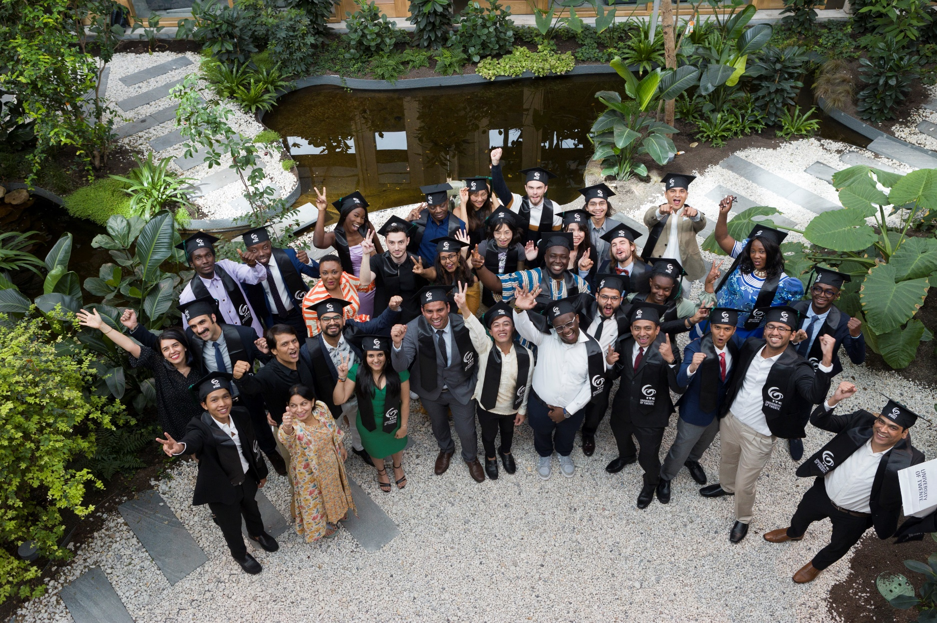
RECOGNITION OF DEGREES
The degrees awarded by the University of Twente are formally recognized by the Ministry of Education, Culture and Science, based on accreditation NVAO
For its degree programmes the University of Twente issues an internationally recognized document attached to diploma: the Diploma Supplement (DS)
In the Shanghai subject ranking 2022 (Subject: engineering | remote sensing), ITC University of Twente ranks:
9th in the world;
4th in Europe;
1st in the Netherlands.
Our education is top-rated in the Netherlands ‘Keuzegids Universiteiten’, multiple years in a row
Also:

Slide 28
RESOURCE SECURITY, DISASTER RESILIENCE, GEO-HEALTH, AND GEO AI
IF YOU ARE INTO
GEO-INFORMATION SCIENCE AND EARTH OBSERVATION
SPATIAL ENGINEERING
In this Master’s, you will acquire the theoretical knowledge, technical skills, and big data analytics competencies to explore, analyse, and visualise geospatial and remote sensing data and design innovative and sustainable solutions to a growing range of global challenges.
In this Master’s, you will learn to address large-scale and complex societal challenges by combining both technical and socio-economic knowledge with a strong basis of spatial data analysis and modelling

Slide 29
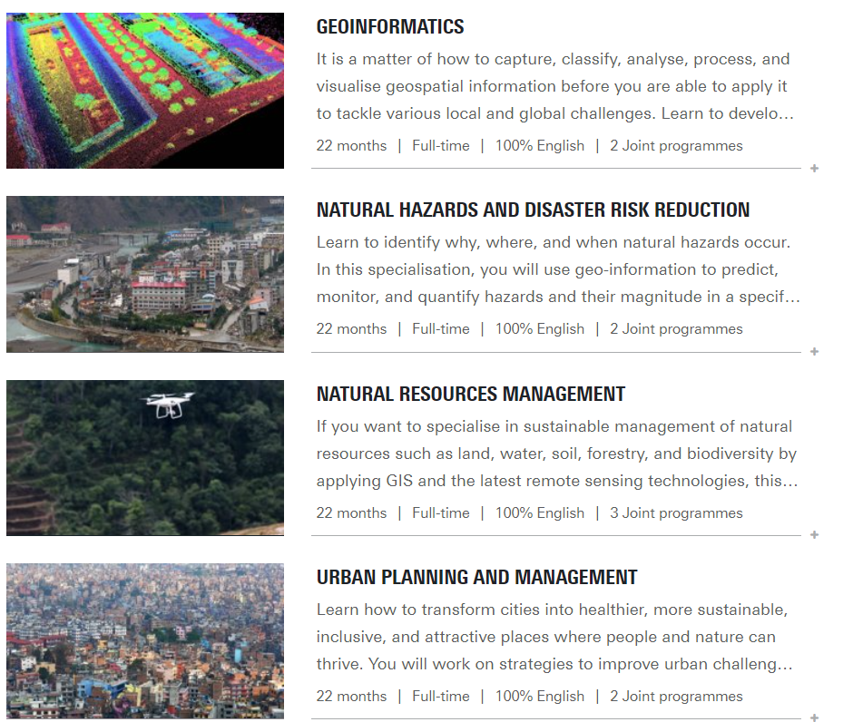
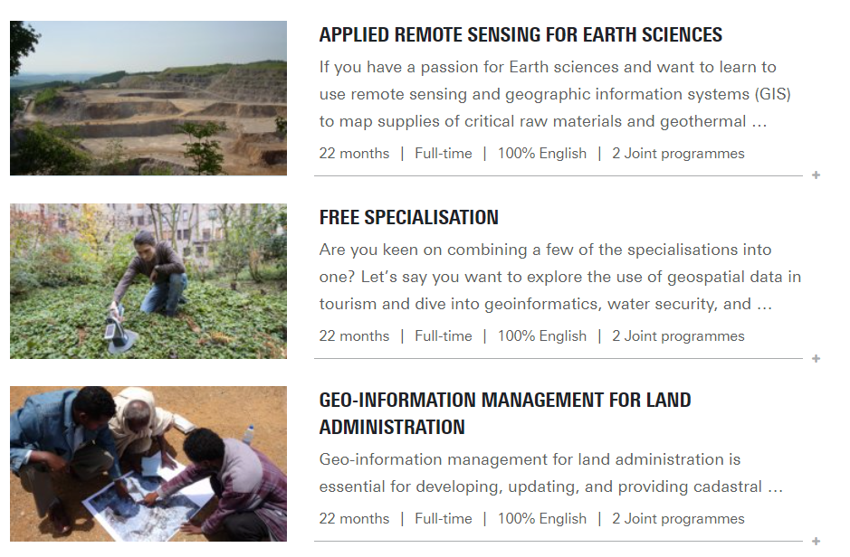
GEO INFORMATION SCIENCES AND EARTH OBSERVATION SPECIALIZATIONS

Slide 30
MASTER’S PROGRAMME STRUCTURE
2-YEAR MASTER PROGRAMME MGEO
FIRST YEAR (60 EC)
COMPULSORY COURSES | SPECIALIZATION – ELECTIVE COURSES
SECOND YEAR (60 EC)
INTERNSHIP | MASTER’S FINAL PROJECT
2-YEAR MASTER PROGRAMME MSE
FIRST YEAR (60 EC)
COMPULSORY COURSES |  | ELECTIVE COURSES
SECOND YEAR (60 EC)
INTERNATIONAL MODULE | MASTER’S FINAL PROJECT |  | INTERNSHIP

Slide 31
MASTER’S PROGRAMME CHOICES
PERSONAL PROGRAMME
Choosing a master’s programme
Choosing a specialization
Choosing electives
Finding an internship position
Finding an interesting master’s thesis
REQUIREMENTS
Proactive
Discussing and communicating
Planning

Slide 32
HOW TO SUCCED DURING YOUR STUDIES
SPECIALIZATION COORDINATOR | INTERNSHIP COORDINATOR | THESIS SUPERVISOR | STUDY ADVISER
Discuss your preferences for your personal course programme | Guides you to find and internship | Supervises your master thesis project | Personal and confidential advice

Slide 33
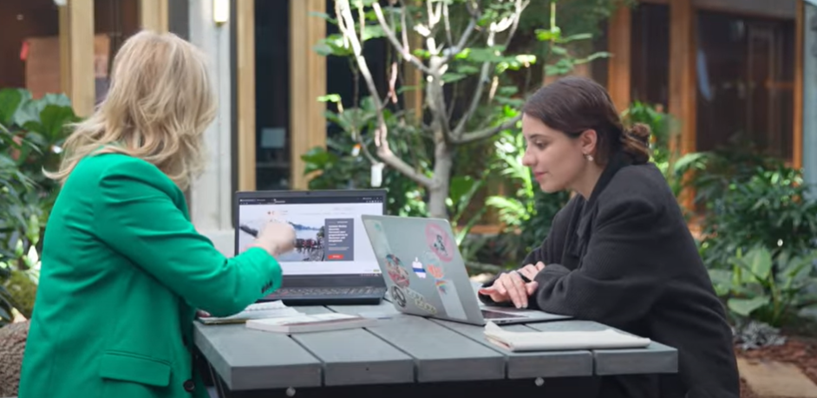
INTERNSHIP OPPORTUNITIES MRS. BELINDA JAARSMA-KNOL ITC INTERNSHIP COORDINATOR
AIM
Apply theoretical and practical knowledge in a professional organization
Learn how to function in an organizational setting
Growth in social and professional attitude
Prepare for your future career
TIMELINE
Year 2
Elective choice for M-GEO, Compulsory for M-SE
10EC for M-GEO, 15EC for M-SE
280 hours workload, 8 weeks min. max. 20 weeks

Slide 34
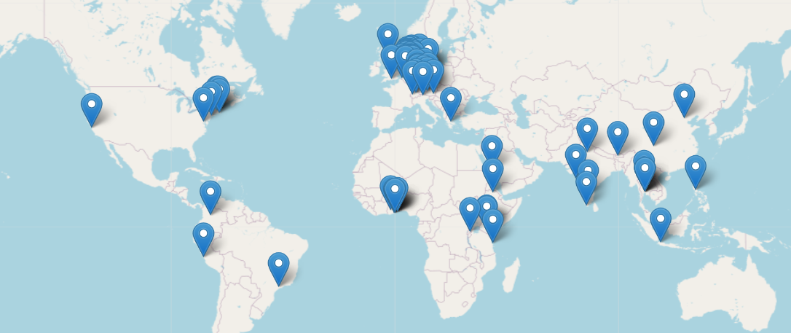
INTERNSHIP OPPORTUNITIES
MORE INFORMATION:
Internship information
Internship experience
WHERE TO GO?
Companies
Institutes
NGO’s
Universities abroad
SUPERVISION
ITC supervisor
Host organization supervisor

Slide 35
WORKING OPPORTUNITIES – GOOD TO KNOW
Side jobs are limited*
A work permit is needed – the employer must apply for it
16 hours a week or three months during summer
A full medical insurance is needed (you can negotiate this with the employer)
Social security contributions and income tax
Zoekjaar = Orientation year after graduation (you can apply for a working permit, up to two years after graduation)
*NOTE: If you are a holder of the Excellence Scholarship Programme, unfortunately you are not eligible for side jobs due to taxes over income.

Slide 36
ADMISSION REQUIREMENTS
DIPLOMA REQUIRED FOR ADMISSION
4-year Bachelor degree with a final cumulative grade point average (CGPA) of at least 80%
Upper Second Class standing or higher
Specific requirements may apply to individual specializations
ENGLISH LANGUAGE CERTIFICATE
IELTS 6.0
TOEFL, internet based (-BT) of 80
Cambridge CAE-C (CPE) obtained with an A, B or C grade

Slide 37
WHAT ABOUT THE COST?
TUITION FEES 2024 MSC PROGRAMMES
COST OF LIVING APPROX. PER YEAR
TOTAL: €1000 x 12 = €12.000
2 YEAR PROGRAMME MSE EU
€ 2.314 = USD 2,443.84
FOOD: €2,500 HOUSING: €5.500
BOOKS + SUPPLIES: €600
2 YEAR PROGRAMME MGEO MSE NON-EU
€ 17,000 – USD 17,953.89
BANK ACCOUNT: €50
BICYCLE: €125 + TRANSPORTATION: €600
BICYCLE: €125 + TRANSPORTATION: €800
*Every year an increment of 1.25% in tuition fees approx.
INSURANCE: €650 + ENTRY VISA/RESIDENCE PERMIT €207

Slide 38
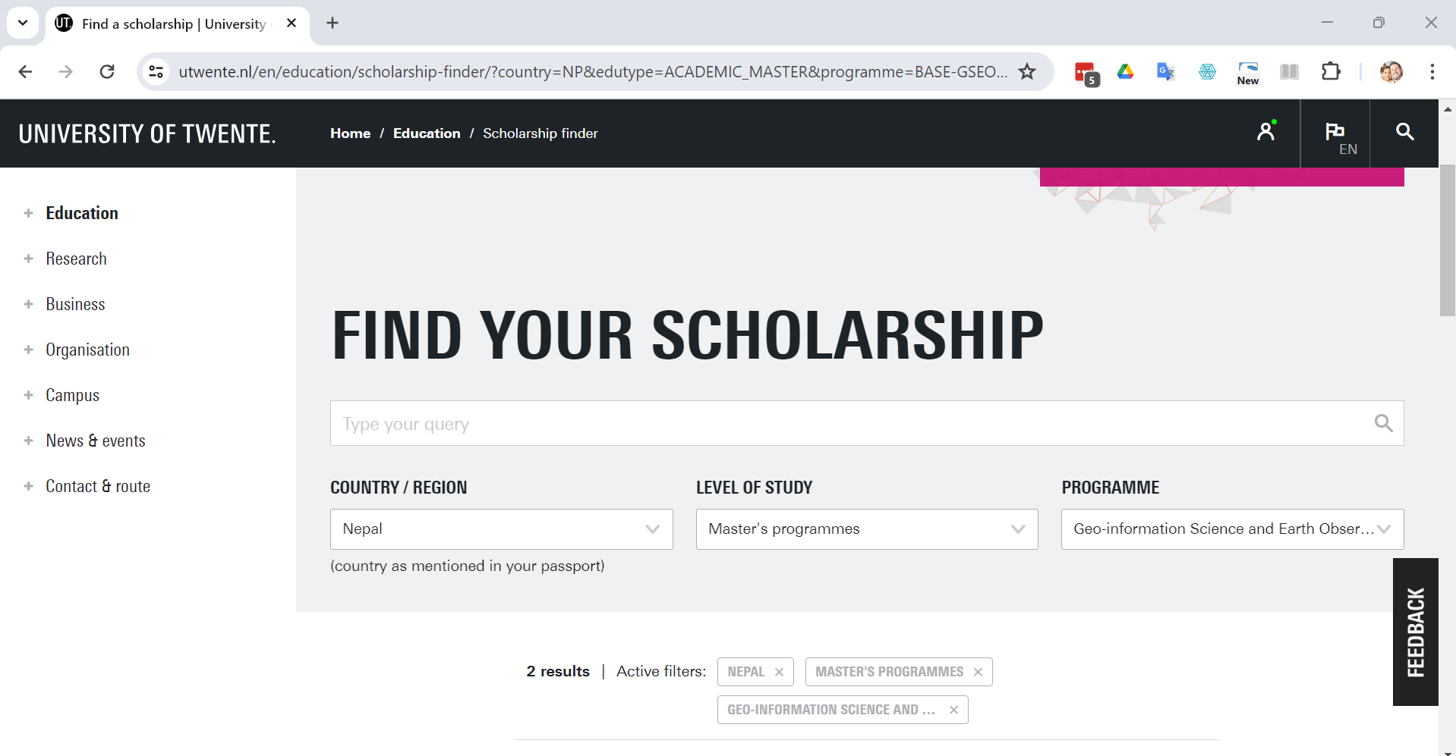
SCHOLARSHIPS
EXCELLENCE SCHOLARSHIP PROGRAMME
Amount: 85% approx.
Deadline: 16 Feb
NL SCHOLARSHIP Amount: €5,000 Deadline: 1 May
https://www.itc.nl/education/study-costs/scholarships/scholarship-finder/

Slide 39
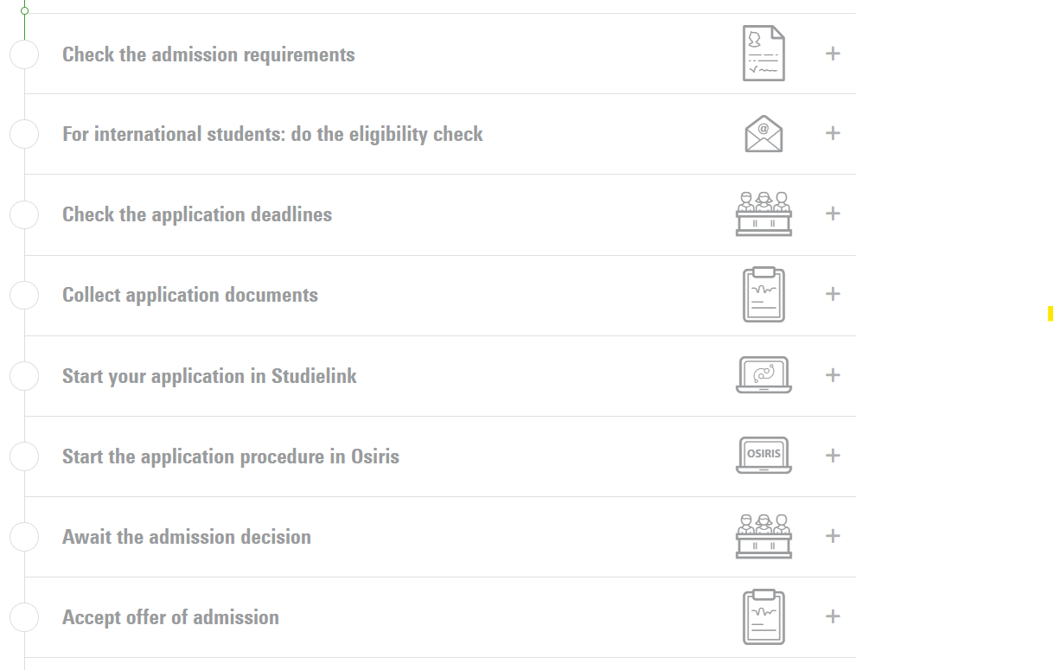
APPLICATION PROCESS AND DEADLINES
Journey Step | Deadline
Start application process | October 1
Confirmation of acceptance | December 1
Tuition Fees Waivers (Early birds) | January 26
ITC Excellence Scholarship Programme | February 16
Tuition Fees Waivers (Early birds) Payment | February 16
ITC Excellence Scholarship Programme Payment | May 1
Completed application with all documents up | 15 July MGEO / 1 July MSE
Visa application ( ~3 months before classes start) | May / June
Book flights | August
Flight to the Netherlands | September
VISIT: HTTPS://WWW.UTWENTE.NL/EN/EDUCATION/MASTER/HOW-TO-APPLY/(INTER)NATIONAL-DEGREE/#STEP-BY-STEP-PLAN

Slide 40
ALUMNI
Worldwide community of over 25,000 individuals
Extensive network of international contacts
- UN organizations
- Universities
- Research groups
- Research survey and map production services
- Various international professional associations

Slide 41
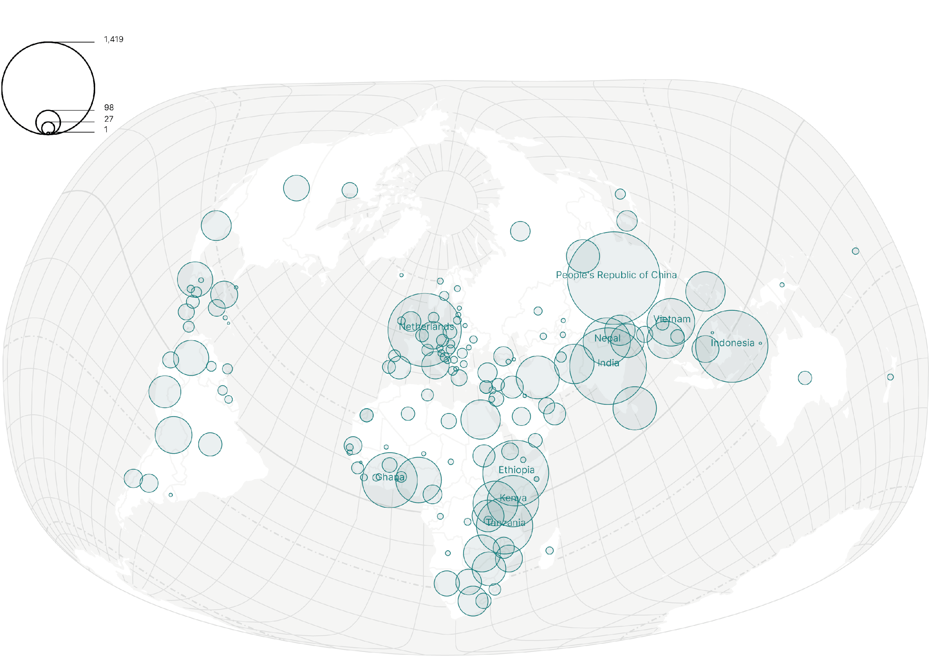
ITC ALUMNI
BY COUNTRY OF ORIGIN
(AS KNOWN IN 2023)
“A STRONG COMMUNITY OF EXPERTS
COMMITTED TO A MORE RESILIENT WORLD”
FREEK VAN DER MEER, DEAN ITC

Slide 42
CAREER PERSPECTIVES
90% of graduates find employment within 12 months of graduating
Graduates are capable of
Unravelling geo-spatial processes and developing (creating) local solutions for global problems as an applied scientist or a geo-information consultant.
Working at the nexus between technical specialists and decision-makers
Working in international teams
ITC alumni work in different sectors | ±
Government agency | 50%
Education and research (incl. PhD) | 20%
Private sector & self employed | 20%
NGO (national & international) | 10%

Slide 43
TALK TO A CURRENT STUDENT

Slide 44
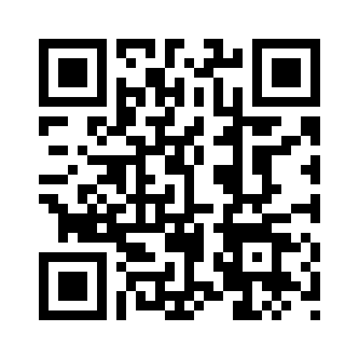
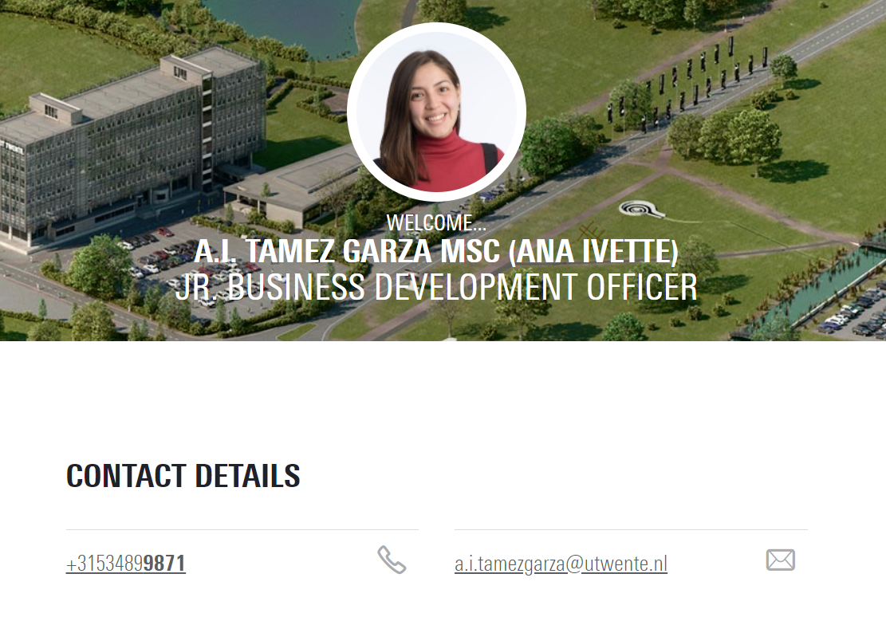
DO YOU WANT TO KNOW MORE?
DOWNLOAD OUR MASTER’S PROGRAMMES BROCHURES
SEND YOUR QUESTIONS TO A.I.TAMEZGARZA@UTWENTE.NL

Slide 45
QUESTIONS?
THANKS FOR LISTENING!

Slide 46
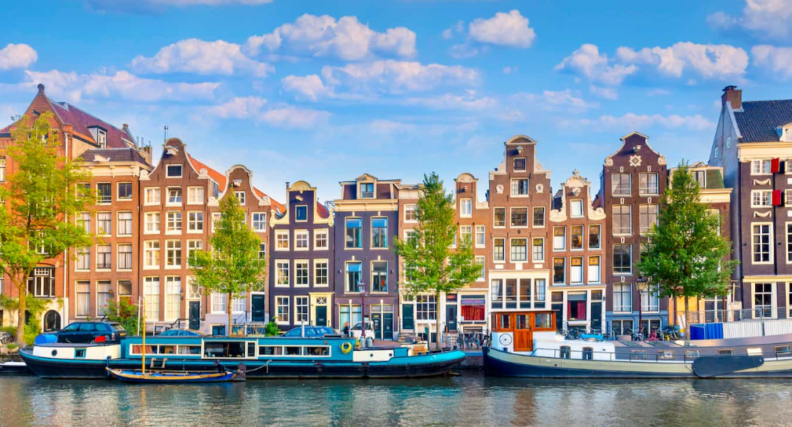
International Master Programmes
of the Vrije Universiteit Amsterdam (VU)

Slide 47
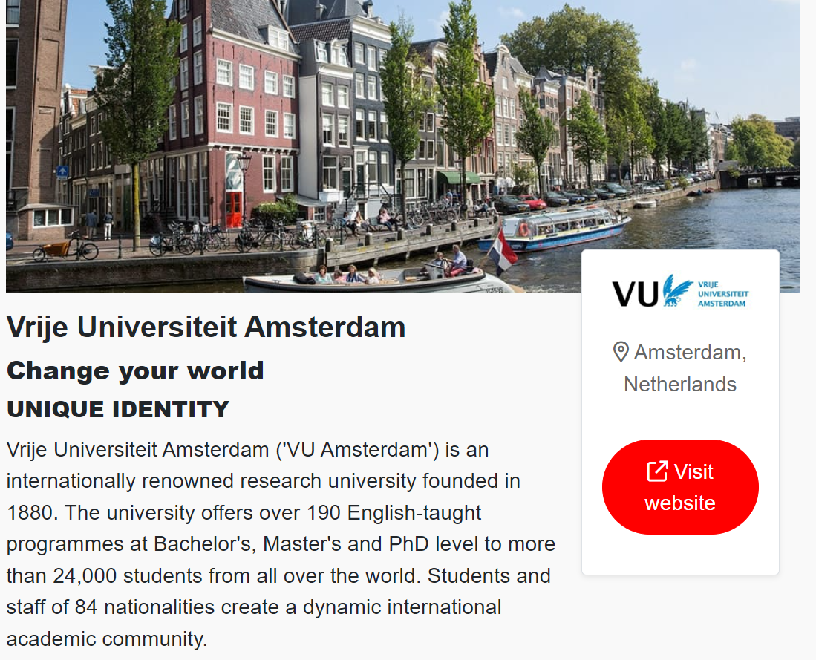
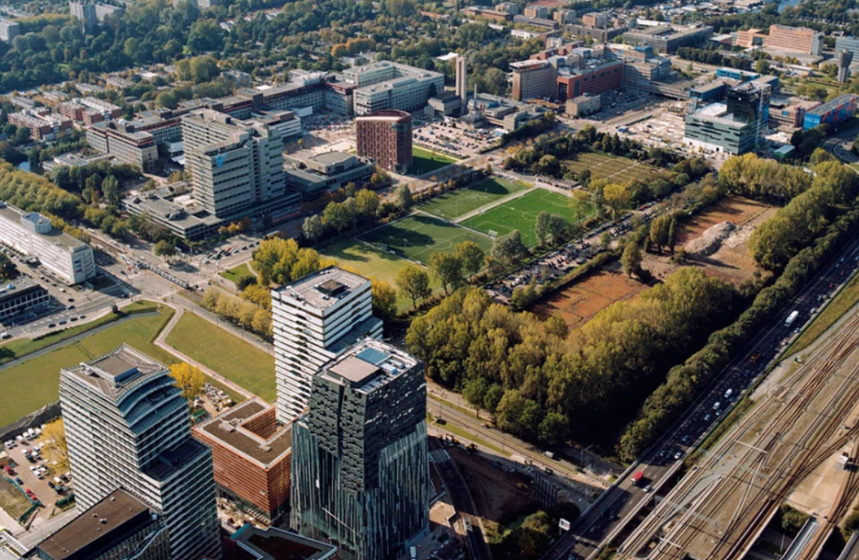
The VU’s city campus

Slide 48
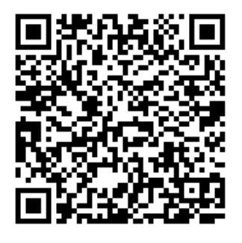
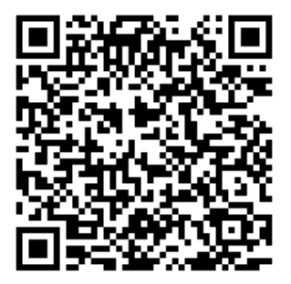
Practical Information: the International Office
https://vu.nl/en/education/more-about/international-student-advisor
https://vu.nl/en/student/student-wellbeing/international-students

Slide 49
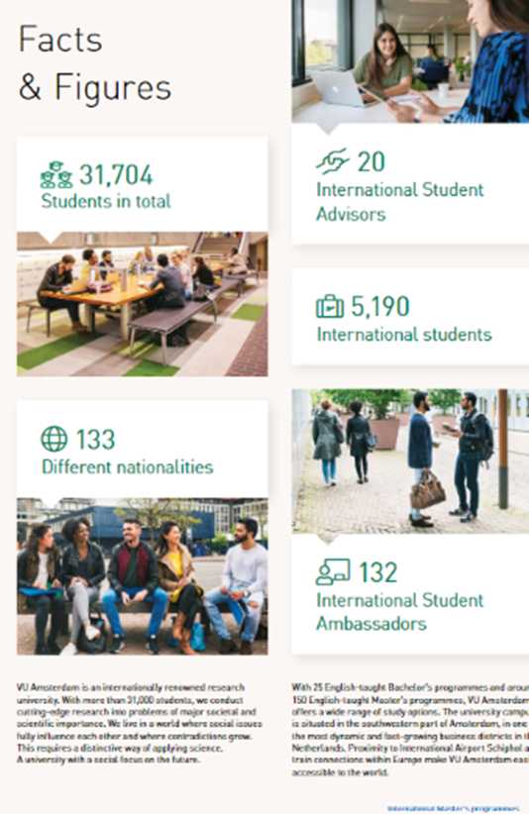
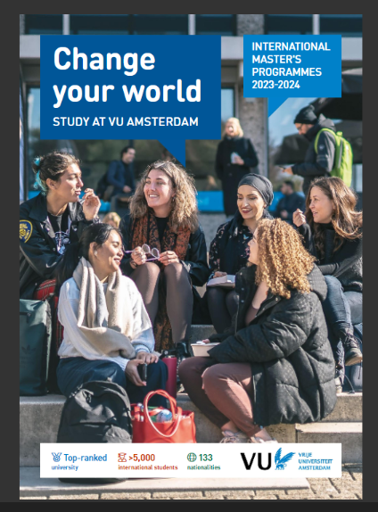
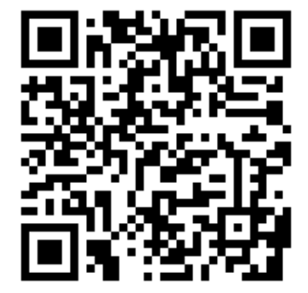
Overview international master’s
https://vu.nl/en/education/master/programmes

Slide 50
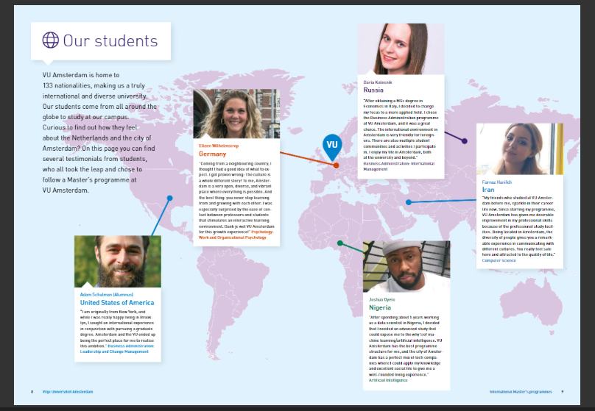
Overview international master’s

Slide 51
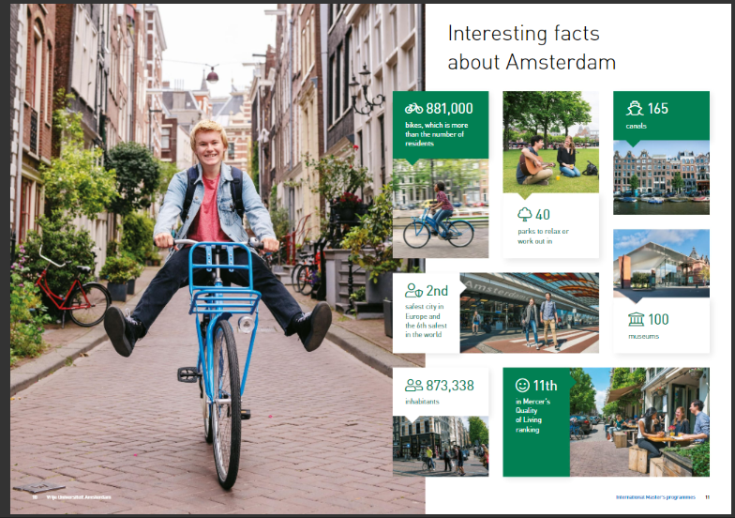
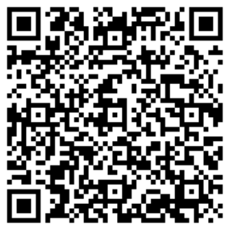
Student life in Amsterdam
https://issuu.com/vuuniversity/docs/international_master_s_brochure_2023-2024

Slide 52
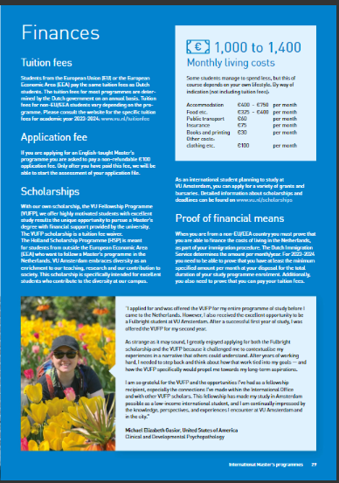

Slide 53
Faculty of
science
Empowering Young Innovators

Slide 54
What is SBI? An R&D Tech Driven Programme
Physics
Chemistry
Mathematics,
Statistics &
Informatics
Business
Administration
From R&D Tech
Driven Innovation
To Market and Society Product
Innovation,
Sciences & Entrepreneurship

Slide 55
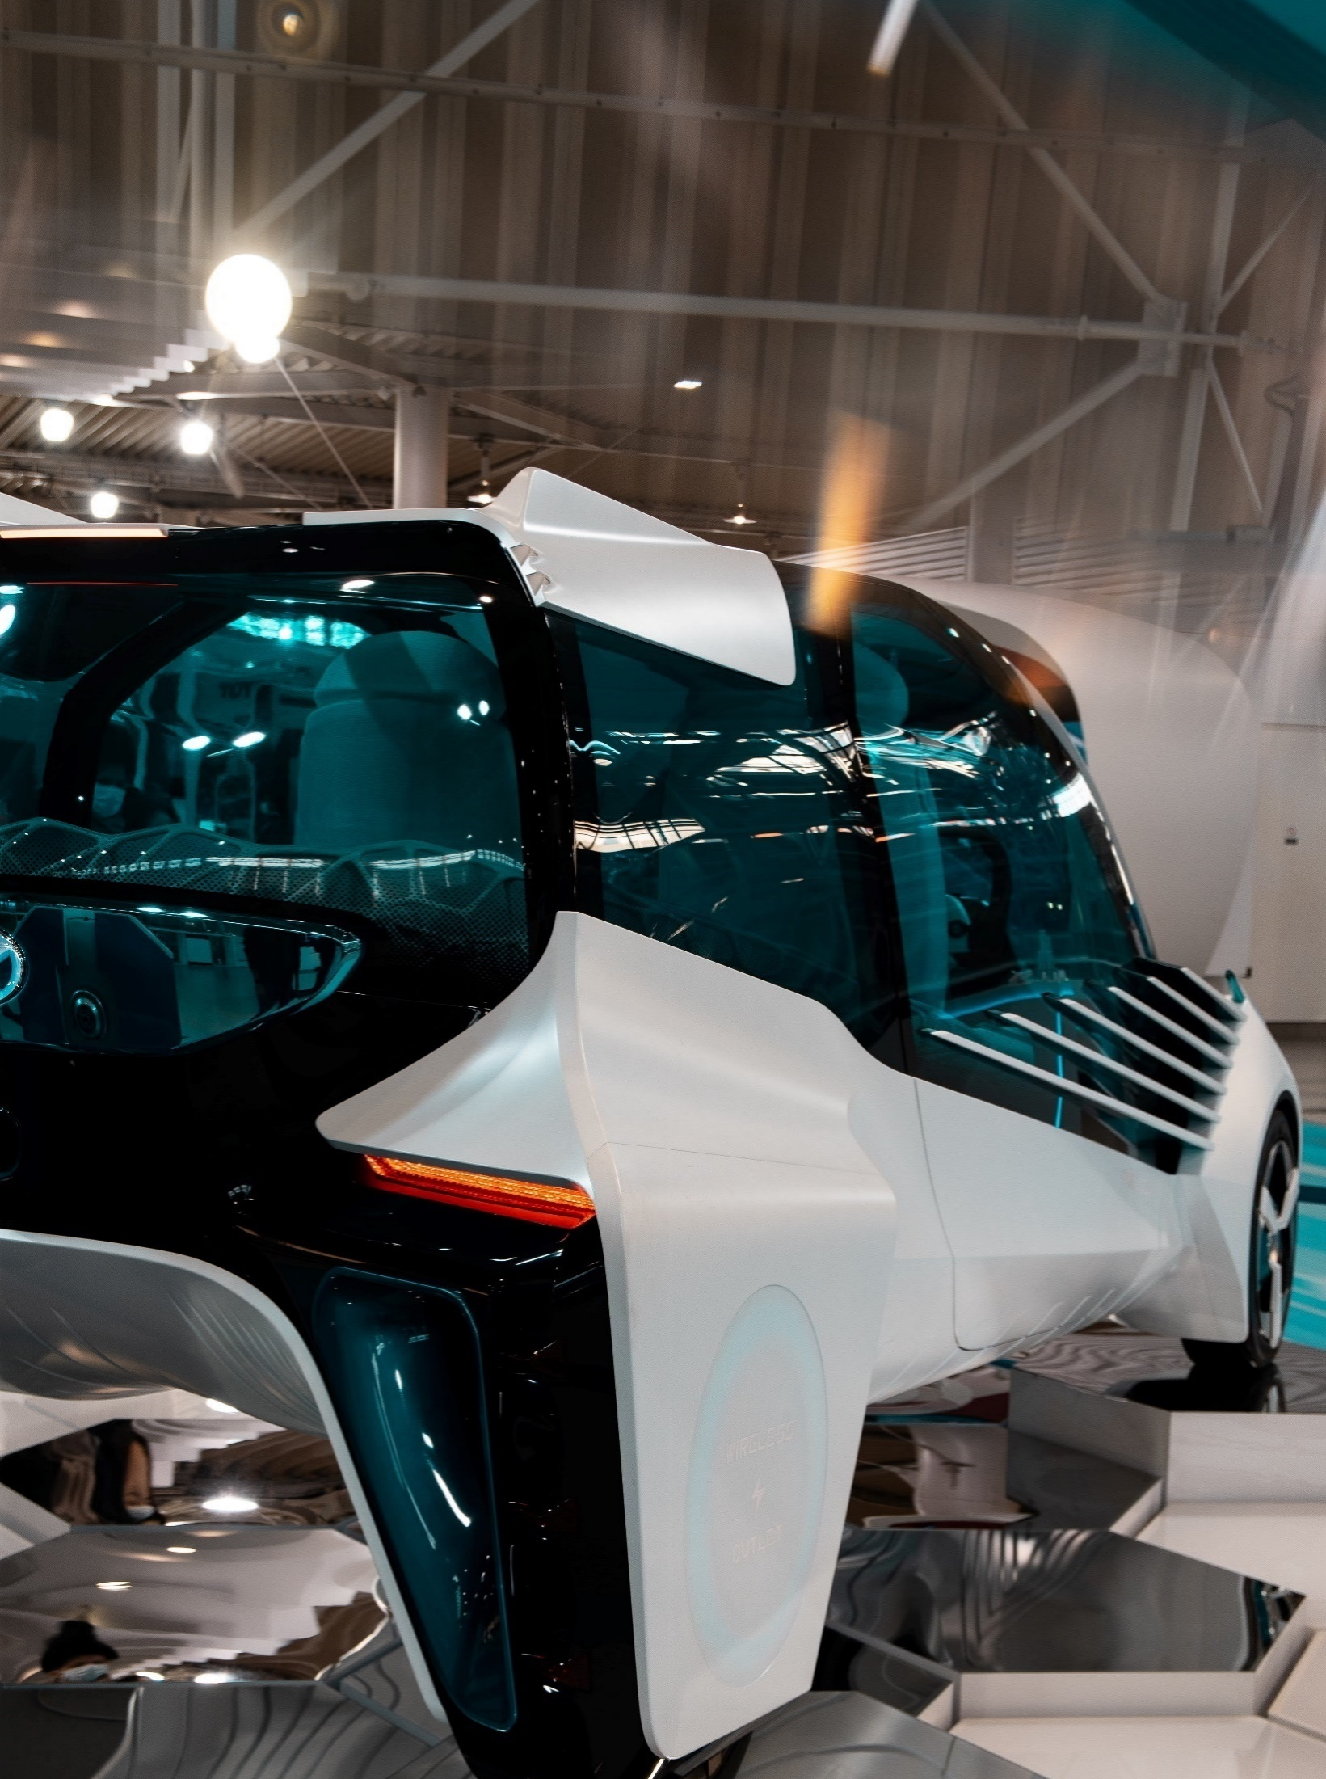
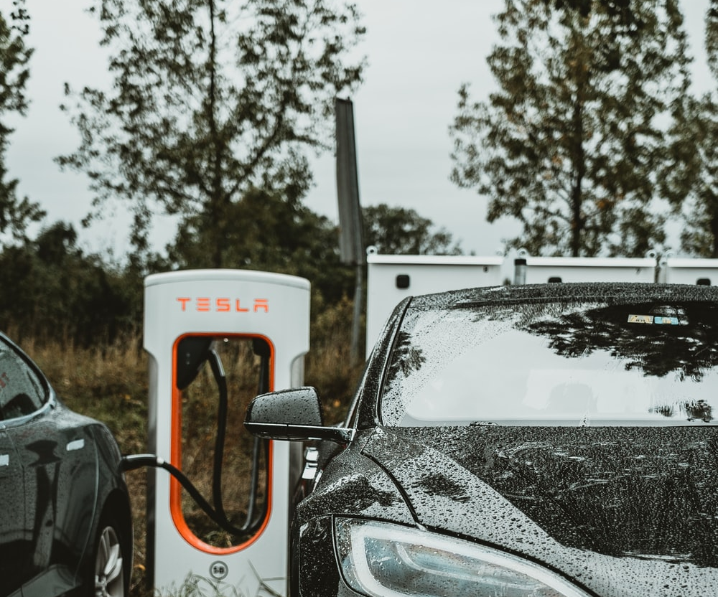
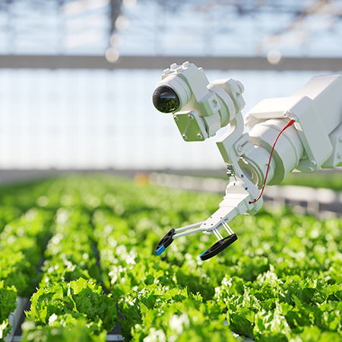
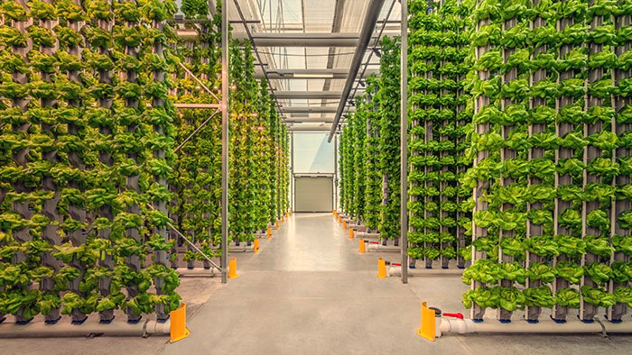
Energy & Sustainability
(Track 1)
Projects and Research
The Future of Hydrogen: Liquid Hydrogen Niche Developments
Identification of Battery Services and Assessment of their grid impact and profitability

Slide 56
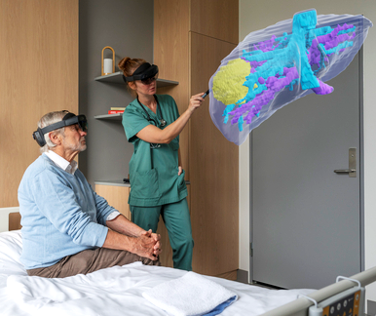
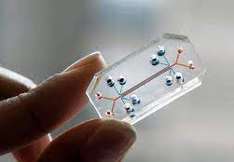
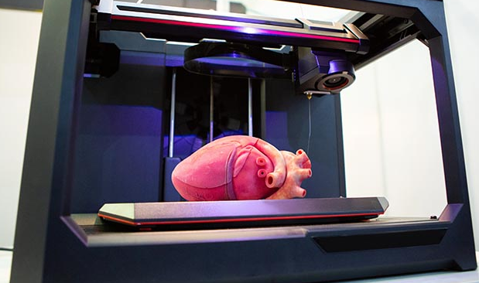
Projects and Research
Mutual Learning Strategies on Artificial Intelligence for Diagnostic Radiology
Acquisition of knowledge by Big Pharma: The case of GPCR-based drug development in oncology
Life & Health
(Track 2)
Notes:
https://www.digitalhealth.net/2024/01/holocare-to-launch-at-leeds-teaching-hospitals-nhs-trust/

Slide 57
SEPTEMBER – OCTOBER
Master Program – Year 1
SBI Research Methodology
Mandatory Courses
Electives
1
12 EC
NOVEMBER – DECEMBER
Mandatory Courses
Electives
12 EC
2
JANUARI
3
6 EC
L&H: Business, Innovation and Value Creation in the Life Science Industry
E&S: Current Sustainable Energy Technologies
4
FEBRUARI – MAY
Science Project
24 EC
5
JUNE
6 EC
Electives
6

Slide 58
SEPTEMBER – OCTOBER
Master Program – Year 2
Mandatory Courses
Electives
12 EC
1
NOVEMBER – DECEMBER
2
12 EC
Mandatory Courses
Electives
3
4
JANUARI – JUNE
36 EC
SBI Master Thesis Project
Following an Internship at a Company
5
6
Master Science, Business & Innovation – Faculty of Science

Slide 59
Personalized Medicines
Projects on
Decarbonization
Sharing Economy
Telemedicine 2.0
Robotics
Food/ Organ 3D printing
R&D Tech driven Innovation Upscaling
Energy Transition
Recycling Market,
Zero waste
Artificial Intelligence
Wearable Devices
Smart Cities
CRISPR gene Editing
Bio-Fuel
Digital Twins

Slide 60
Admission Master Programme
Registration OPEN to anyone with a Bachelor’s degree:
Basic Knowledge on Bachelor level of Mathematics (< 9 EC);
Statistics (< 6 EC);
Computer Skills (< 6 EC); and
Business/ Innovation Sciences (< 24 EC)
45 ECTS obtained via Bachelor’s degree on: Chemistry and/or Physics courses
E&S track including Thermodynamics
L&H track including Molecular and Pharmaceutical Sciences

Slide 61
S
Contact our Advisor:
e.h.kroezinga@vu.nl
Prof. Kees Boersma: f.k.boersma@vu.nl
Or have a look at our Website for our Programme!
Master Science, Business & Innovation – Faculty of Science

Slide 62
Culture, Organization and management (COM)
Faculty of social Sciences
Prof. Kees Boersma f.k.boersma@vu.nl
62

Slide 63
COM… a multidisciplinary social sciences master
Sociology
Psychology
Anthropology
etc.
COM… an international master
and a mixed classroom
Student composition
30% International
40% Dutch Bachelor’s
30% Premaster
Faculty of Social Sciences / Organization Sciences Culture, Organization and Management

Slide 64
COM is about: organizing as a cultural process
What management books promise…
What everyday organizing is about…
VnU

Slide 65
Frontstage appearance/ Backstage practices
Frontstage
Question: interested in what happens behind the scenes?
Backstage
http://liesbethwesterlaken.nl/tatarstan

Slide 66
1 year Master Program COM
Programme Master COM
Sep-Oct | Nov-Dec | Jan | Feb-Mar | Apr-May | Jun
Organization & Power | Changing Organizational Culture |  | Fieldwork & Master’s Thesis
 | Choose 1 out of 2:
Sensemaking in Organizations | Culture & Identity in Organizations
 | Transnational Organizations in a Global World
 | From Fascination to Fieldwork |  |  | From Fieldwork to Future
Faculty of Social Sciences / Organization Sciences Culture, Organization and Management
Notes:
Plaatje zoeken met
BOVEN
ONDER
UP DOWN

Slide 67
Teaching methods
mix of methods
On-campus lectures
Wild: 'on location'
online: interactive
films & knowledge clips
Group projects
Case study sessions
Faculty of Social Sciences / Organization Sciences Culture, Organization and Management

Slide 68
IMPORTANT INFORMATION
International students: https://vu.nl/en/education/more-about/apply-masters-programme
Admissions: https://vu.nl/en/education/master/culture-organization-and-management/admissions
Faculty of Social Sciences / Organization Sciences Culture, Organization and Management

